Slide 1
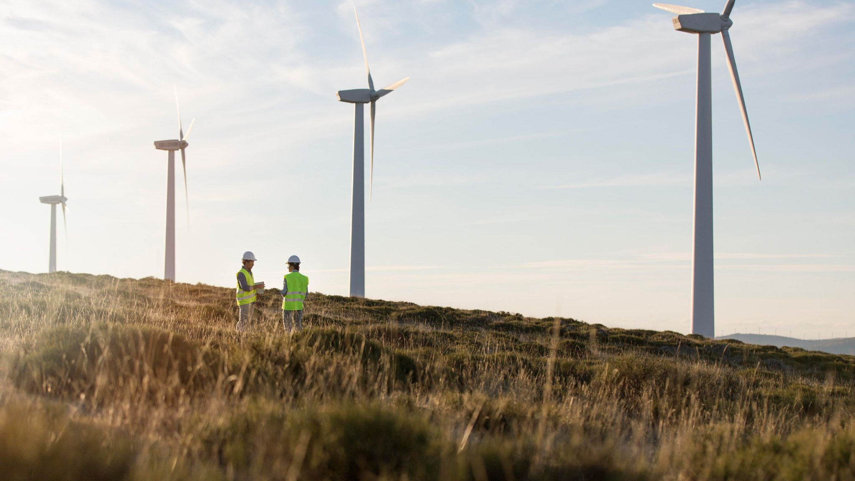

Slide 2
—Thomas S. Monson
We cannot direct the wind, but we can adjust the sails

Slide 3
Wind Turbine
Renewable Energy Resourse

Slide 4
Team
01
02
03
04
05
Member 1
Member 2
Circuits & Diagram
Designs & Graphics
Member 3
Member 4
Animation
History & Background
Member 5
Composition & Data collection

Slide 5
Table Of Content Wind Turbine
01
02
03
04
05
06
07
Introduction
Objective
Background & History
Locations
Components
Diagram
Wind energy systems
Circuits & Diagram
Model
Usage
Animation & Designs
Comparision
Conclusion

Slide 6
01
Wind turbines
The Future of Power Generation

Slide 7
Introduction To Wind Turbine
Wind turbines convert wind energy into electricity using large rotating blades connected to a generator. As a vital part of renewable energy, they help reduce carbon emissions and promote sustainable solutions for a greener future.

Slide 8
History of wind energy
- Ancient Use(500-900 AD ): Wind energy was harnessed for milling grain and pumping water by ancient civilizations around.
- Modern Development(1887): The first electricity-generating wind turbine was created by James Blyth.
-Early 20th Century: Small wind turbines provided electricity to rural homes and farms in the U.S. and Europe.
-Post-War Growth: The 1970s oil crisis sparked renewed interest in wind power, leading to technological advancements.
-Current Era: Wind energy is now a rapidly growing global electricity source, driven by innovation and investment.

Slide 9
Why Wind Turbine?
Renewable Energy
Low Operating Costs
Job Creation
A never ending energy resource
Minimal maintenance needed.
Support manufacture and maintenance jobs
Energy Independence
Environmental Benefits
Reduces reliance on imports
Zero emissions during operation

Slide 10
Important windmill locations
An ideal Location for Windmill is
Open Area (for winds to blow clearly) Coastal Regions (as the air current is strong near sea) Deserts (No obstacle to block or slow the wind

Slide 11
Main Components required
Name | Quantity | Description
Servo Motor/ Dynamo | 1 | Use to generate Power
Blades | 4 | To convert kinetic energy into electrical
Rotor | 1 | To combine blades with the motor
Led | 1 | To use power generated by the turbine

Slide 12
Wind energy systems
A wind turbine converts wind energy into electricity by using large blades that rotate when the wind blows. This rotation drives a generator, producing electricity, which is then transformed for use and transmitted to the grid. Modern turbines optimize their position to maximize energy capture and efficiency.

Slide 13
Energy generation system
Wind Blew
Storing Power
Energy Conversion
Use Energy
01
03
02
04
Blades moves
Into the battery
Kinetic to Electrical
Turn on LEd

Slide 14
Diagram
Energy Generation
Wind flow
Storing or Usage of Energy
When the blades rotate they make the turbine inside rotates
Which makes the blade rotate
When Electricity is generated it is further stored into batteries or used

Slide 15
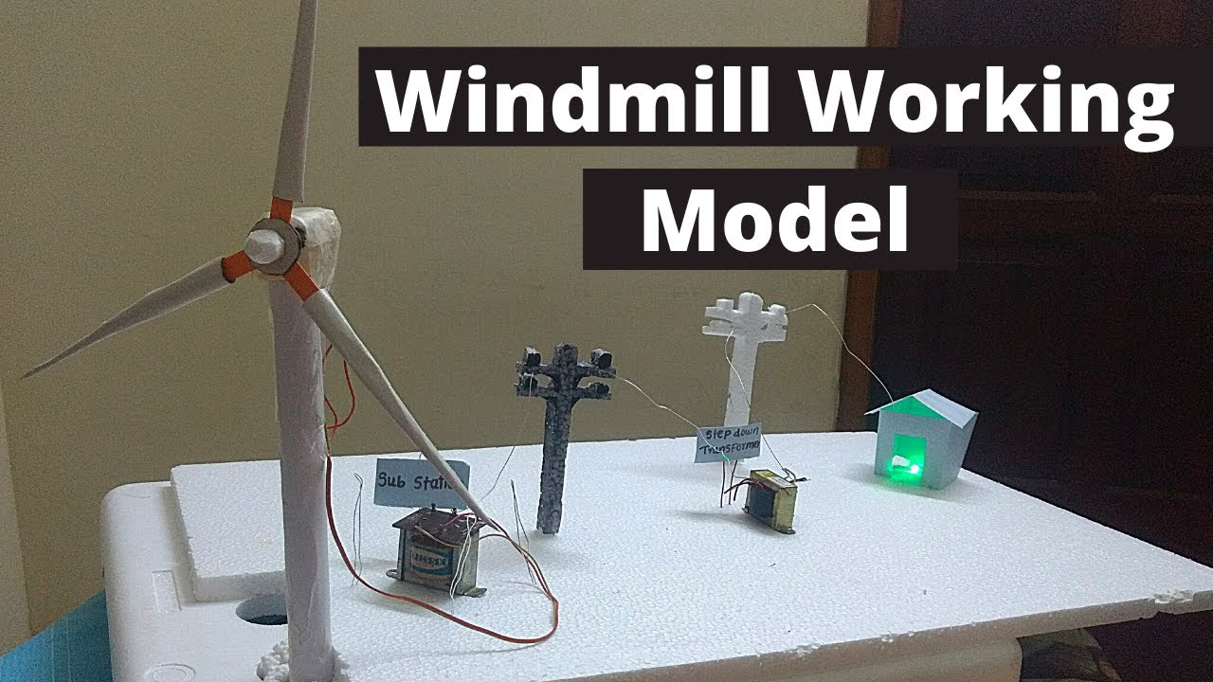

Slide 16
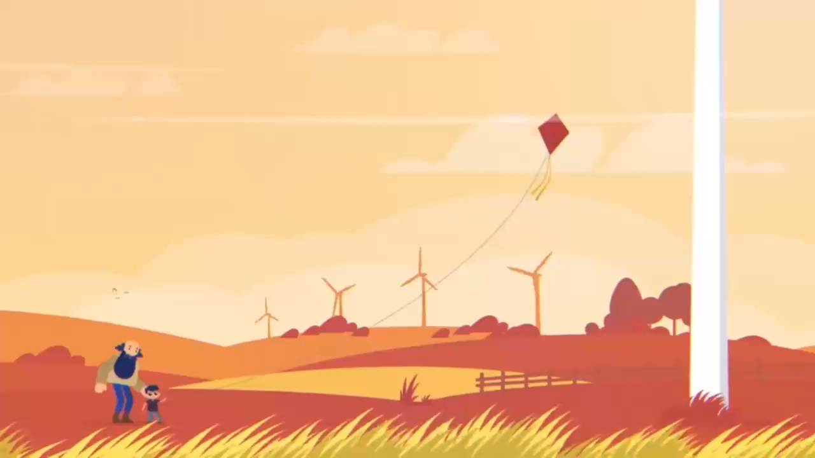
Wind Turbine Working Animation
Generation to Usage

Slide 17
Wind Turbines Over the Years
1950-1999
2000-Present
2%
10%
40%
Wind turbines are vital for global power generation, harnessing renewable energy to reduce fossil fuel dependence.
1900-1949

Slide 18
Comparison
Advantages | Disadvantages
Renewable Energy Source | High Initial Costs
Technological Advancements | Intermittent Energy Production
Low Operating Costs | Impact on Wildlife
Land Use Flexibility | Visual Impact

Slide 19
Any Questions?
Thank you

